Slide 1

EUROCarbDB
presented by René Ranzinger

Slide 2
GlycoCT and Structureinput
1. Development of a new sequence format for carbohydrates
Heterogeneity of carbohydrate structures input
Analysis of existing carbohydrate sequence formats
GlycoCT
2. Input of carbohydrate structures for EUROCarbDB
GlycanBuilder
Table of Contens

Slide 3
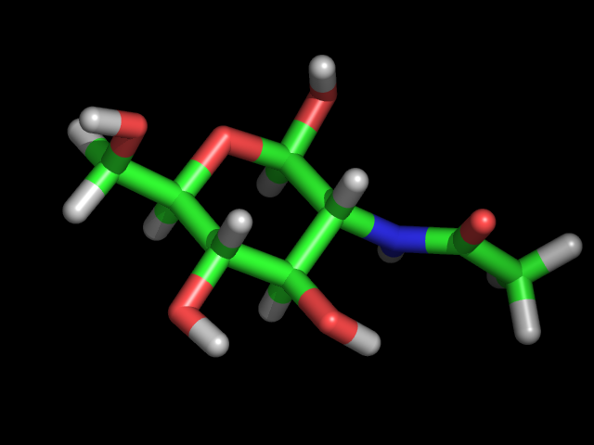
GlycoCT and Structureinput
Residue level - information content
Anomer (alpha, beta, unknown ...)
Chirality (D,L,unknown)
Stereoinformation (glc,man,...)
Superclass (triose, hexose ...)
Ring closure (pyranose,unknown ...)
Modification (deoxy, keto ... )
Substitution (methyl, n-acetyl ...)
1.1 Heterogeneity of glycan structures input

Slide 4
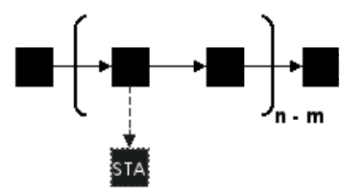

GlycoCT and Structureinput
Topology level – information content
- linkages between residues (none, unknown positions, multiple ...)
- linear & branched
- repeat units (unknown or interval count)
- statistical distribution
- cyclic
- uncertain terminal residues
- alternative residues
a-D-Glcp-(1-4)-b-D-Galp|b-D-Manp-(1-4)-a-D-Glcp
1.1 Heterogeneity of glycan structures input

Slide 5
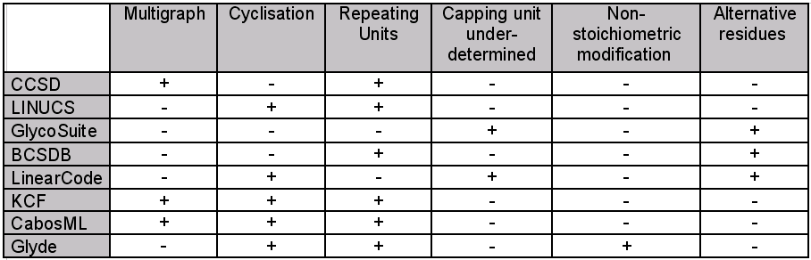
GlycoCT and Structureinput
- IUPAC notations
- KCF (from KEGG)
- Glyde 1.0
- LINUCS
- GlycoSuite notation
- OGBI glycan nomenclature
- BCSDB notation
- LinearCode (GlycoMinds)
- CCSD (Carbbank)
1.2 Analysis of existing glycan sequence formats

Slide 6

GlycoCT and Structureinput
RES
1b: Basetype 1
2b: Basetype 2
3s: Substituent 1
4b: Basetype 3
...
LIN
1:1o(4+1)2d
2:2d(2+1)3n
...
- connection table based format
- unique string for a glycan sequence
- handles all features of structure input
REP1:8o(4+1)9d=-1—1
RES
...
LIN
...
...
UND1:100.0:100.0
ParentIDs: parents
SubtreeLinkageID1: u(2+1)u
RES
...
LIN
...
ALT1
ALTSUB1
RES
...
LIN
...
...
GlycoCT

Slide 7
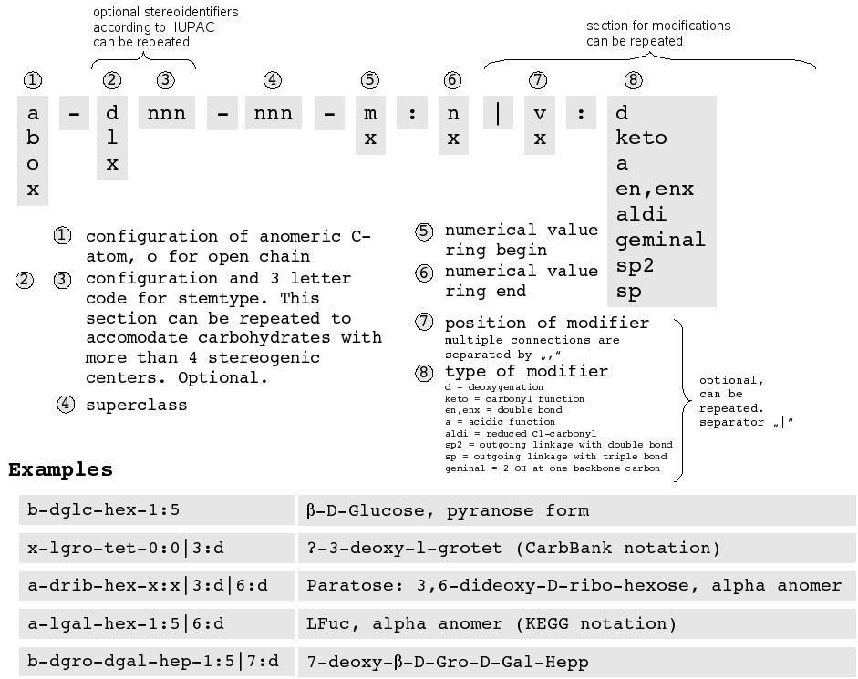
GlycoCT and Structureinput
GlycoCT

Slide 8
GlycoCT and Structureinput
GlycoCT
LINUCSID:13928 ; 93(60) residues
GlycoCT_{XML}
GlycoCT_{condensed}
<?xml version="1.0" encoding="UTF-8"?>
<sugar version="1.0">
<residues>
<monosaccharide id="1" type="b" anomer="b" superclass="hex"
ringStart="1" ringEnd="5" name="b-dglc-HEX-1:5">
<basetype id="1" type="dglc" />
</monosaccharide>
...
</residues>
<linkages>
<connection id="1" parent="1" child="2">
<linkage id="1" parentType="o" childType="d">
<parent pos="4" />
<child pos="1" />
</linkage>
</connection>
...
<repeat>
<unit id="1" minOccur="-1" maxOccur="-1">
<residues>
<monosaccharide id="59" type="b" anomer="b"
superclass="hex" ringStart="1" ringEnd="5"
name="b-dgal-HEX-1:5">
<basetype id="1" type="dgal" />
</monosaccharide>
...
</repeat>
</sugar>
RES
1b:b-dglc-HEX-1:5
2b:b-dglc-HEX-1:5
3s:n-acetyl
...
57b:a-dgro-dgal-NON-2:6|1:a|2:keto|3:d
58s:n-acetyl
LIN
1:1o(4+1)2d
2:2d(2+1)2n
...
REP
REP1:60o(4+1)59d=-1--1
...
3319 characters
GlycoCT_{compressed}
H4sIAAAAAAAAAI2WQW8cNwyF7/NLHAQLDCmSk
gj0aKAFCrdILr3a2cCHuruAk0sB//g+UWqrWH
uY...ilOkZMcQTlScx/8AYdScnfcMAAA=
1374 characters
35836 characters
GlycoCT

Slide 9
GlycoCT and Structureinput
1. Development of a new sequence format for carbohydrates
Heterogeneity of carbohydrate structures input
Analysis of existing carbohydrate sequence formats
GlycoCT
2. Input of carbohydrate structures for EUROCarbDB
GlycanBuilder
Table of Contens

Slide 10
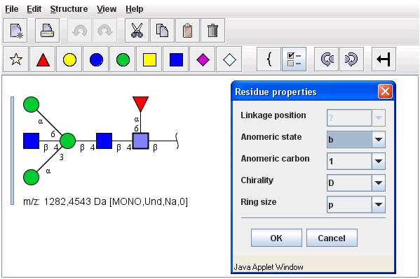
GlycoCT and Structureinput
http://www.dkfz-heidelberg.de/spec/EUROCarbDB/GlycoWorkbench/builder.html
GlycanBuilder

Slide 11

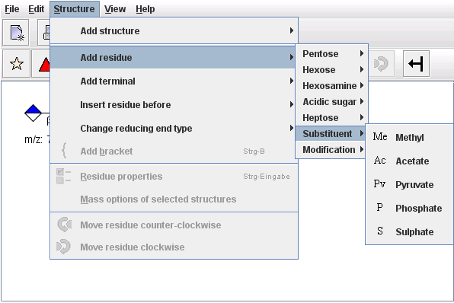
GlycoCT and Structureinput
http://www.dkfz-heidelberg.de/spec/EUROCarbDB/GlycoWorkbench/builder.html
GlycanBuilder

Slide 12
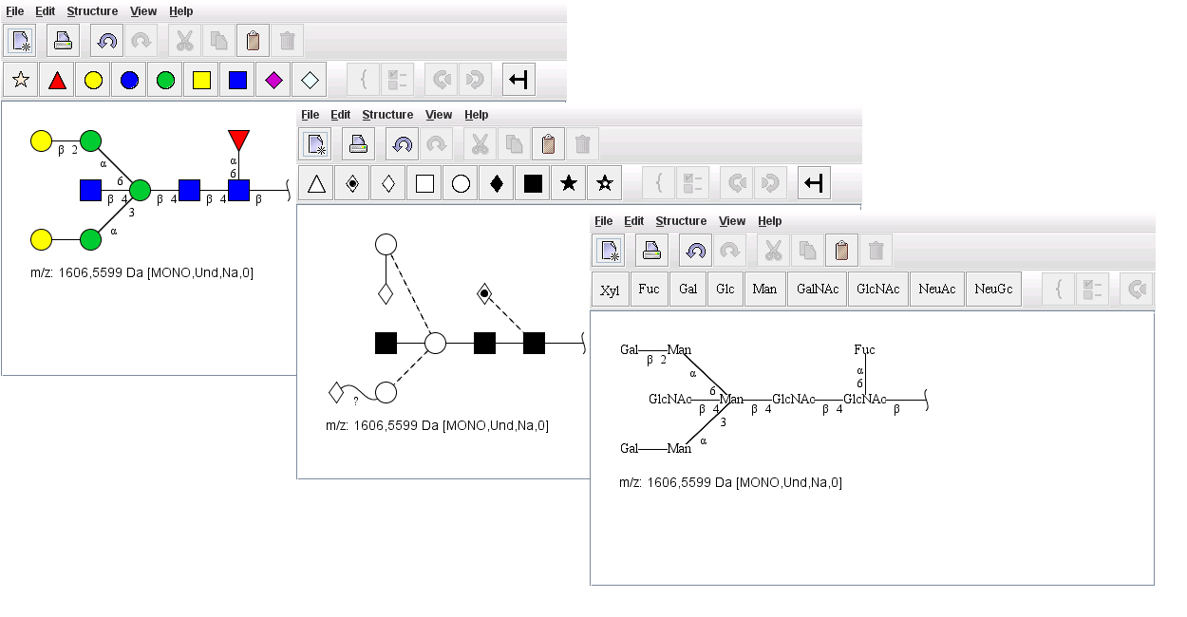
GlycoCT and Structureinput
http://www.dkfz-heidelberg.de/spec/EUROCarbDB/GlycoWorkbench/builder.html
GlycanBuilder

Slide 13
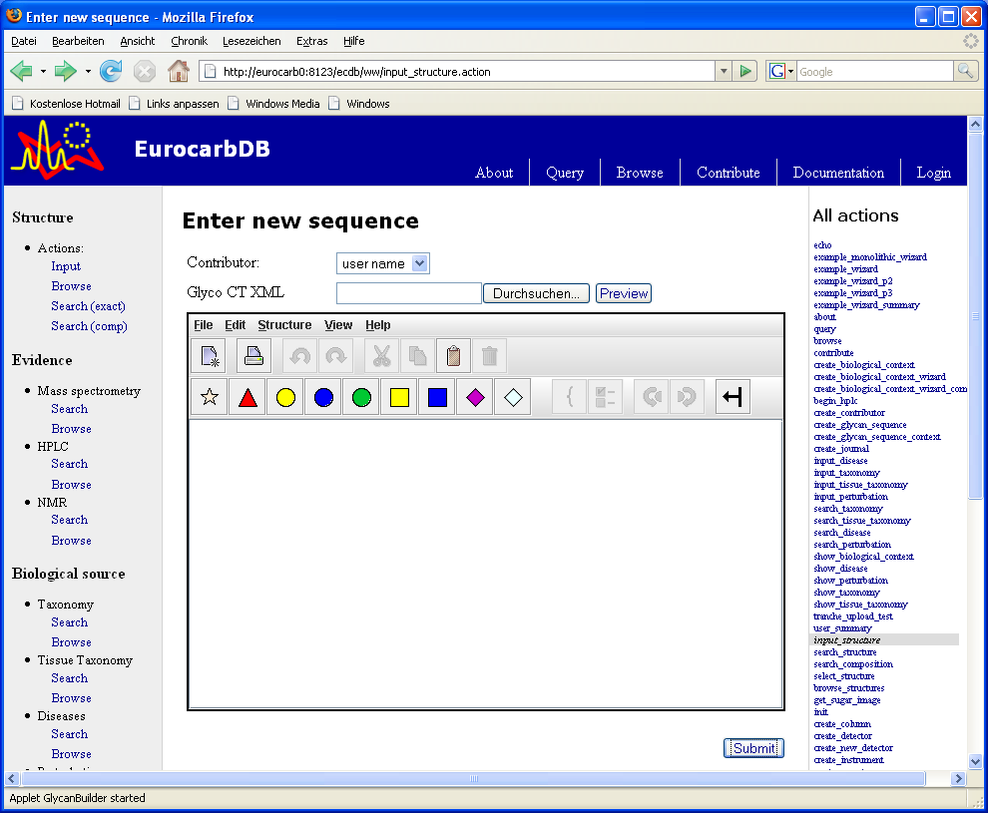
GlycoCt and Structureinput
Structure input in EUROCarbDB
Structure input

Slide 14
www.eurocarbdb.org

